Slide 1


Using Node.js with Visual Studio Code
Stacey Mulcahy | Technical Evangelist
Rami Sayar | Technical Evangelist

Slide 2

Meet Stacey Mulcahy | ‏@bitchwhocodes
Technical Evangelist, Microsoft NYC
Focuses on HTML/JS, IoT, Design & UX
Interviews designers & developers http://bit.ly/1CPUJNX
Talks Marketing & IoT on Channel 9 http://channel9.msdn.com/niners/bitchwhocodes
Blogs at http://thebitchwhocodes.com

Slide 3
Meet Rami Sayar | @ramisayar
Technical Evangelist, Microsoft Montreal
Focuses on Web, HTML5/JS, Node, Microsoft Edge
Helps Startups & Developers in Montreal.
Blogs at blogs.msdn.com/b/cdndevs/ & ramisayar.com

Slide 4
Course Topics
Using Node.js with Visual Studio Code
01 | Introduction to Node.js | 04 | Building a Front-end for your Express Web Apps.
02 | Introduction to Express | 05 | Debugging & Deploying Node.JS
03 | Express and Databases | 06 | Extending Node.JS with Azure Web Jobs

Slide 5
Setting Expectations
Target Audience
Web Developers
Web Designers
Developers with experience using other service side languages such as PHP, ASP.NET, Python, Ruby etc.
Suggested Prerequisites/Supporting Material
Software: aka.ms/node-101
Books: Mastering Node

Slide 6

Join the MVA Community!
Microsoft Virtual Academy
Free online learning tailored for IT Pros and Developers
Over 1M registered users
Up-to-date, relevant training on variety of Microsoft products
“Earn while you learn!”
Get 50 MVA Points for this event!
Visit http://aka.ms/MVA-Voucher
Enter this code: BldAppsnodejs (Expires 11/14/2014)

Slide 7
01 | Introduction to Node.js
Stacey Mulcahy | Technical Evangelist
Rami Sayar | Technical Evangelist

Slide 8
Module Overview
About Node
Setting up your environment
First Node application
Node Package Manager (NPM)

Slide 9
Code Repository: github.com/sayar/NodeMVA

Slide 10
01 | About Node
Stacey Mulcahy | Technical Evangelist
Rami Sayar | Technical Evangelist

Slide 11
What is Node?
Node.js is a runtime environment and library for running JavaScript applications outside the browser.
Node.js is mostly used to run real-time server applications and shines through its performance using non-blocking I/O and asynchronous events.

Slide 12
About Node
Leverage skills with JavaScript now on the server side
Unified development environment/language
High Performance JavaScript Engines – V8
Open source, created in 2009 by Ryan Dahl
Windows, Linux, Mac OSX
Still in “beta” phase

Slide 13
When to use Node
Node is great for streaming or event-based real-time applications like:
Chat Applications
Real time applications and collaborative environments
Game Servers
Ad Servers
Streaming Servers
Node is great for when you need high levels of concurrency but little dedicated CPU time.
Great for writing JavaScript code everywhere!

Slide 14
Node in the Wild
Microsoft
Yahoo!
LinkedIn
eBay
Dow Jones
Cloud9
The New York Times, etc

Slide 15
The Node Community
Five years after its debut, Node is the third most popular project on GitHub.
Over 2 million downloads per month.
Over 20 million downloads of v0.10x.
Over 81,000 modules on npm.
Over 475 meetups worldwide talking about Node.
Reference: http://strongloop.com/node-js/infographic/

Slide 16
01 | Setting up your environment
Stacey Mulcahy | Technical Evangelist
Rami Sayar | Technical Evangelist

Slide 17
Installing Node on Windows
http://nodejs.org/ - pre-complied Node.js binaries to install
https://github.com/joyent/node/wiki/Installation - building it yourself
Via Chocolatey – package manager for Windows:
choco install nodejs.install

Slide 18
Path Variable
Double check that the node executable has been added to your PATH system environment variable.
https://www.youtube.com/watch?v=W9pg2FHeoq8 To see how to change your environment variables on Windows 8 and Windows 8.1.
You will want to make sure the following folder has been added to the PATH variable: C:\Program Files (x86)\nodejs\

Slide 19
Installing Node on Ubuntu
Easiest is to install via the terminal using the package manager.
You also want to install compilers and build essential tools for packages that might need them.
sudo apt-get install build-essential
sudo apt-get install nodejs npm

Slide 20
01 | First Node Application
Stacey Mulcahy | Technical Evangelist
Rami Sayar | Technical Evangelist

Slide 21
Hello World Application

Slide 22
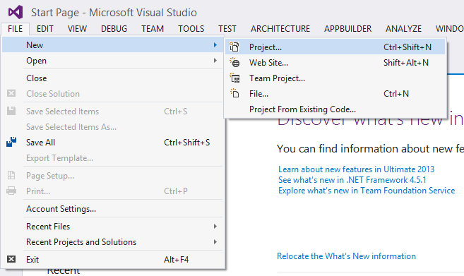
Starting a Node Project in Visual Studio

Slide 23
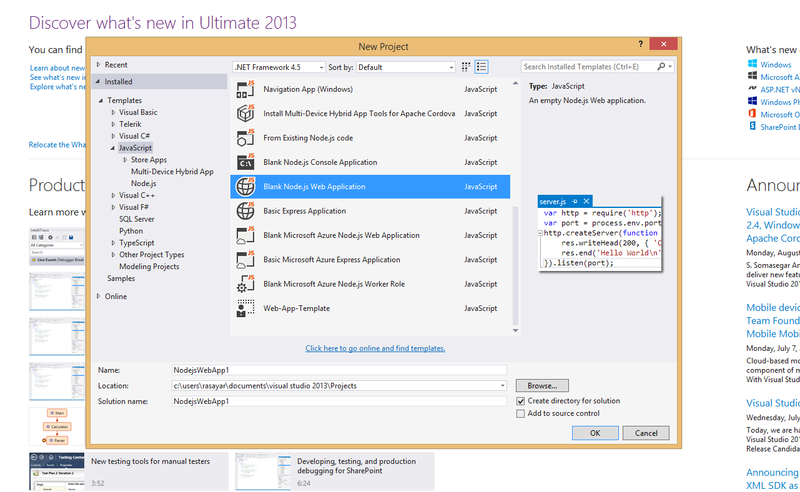
Starting a Node Project in Visual Studio

Slide 24
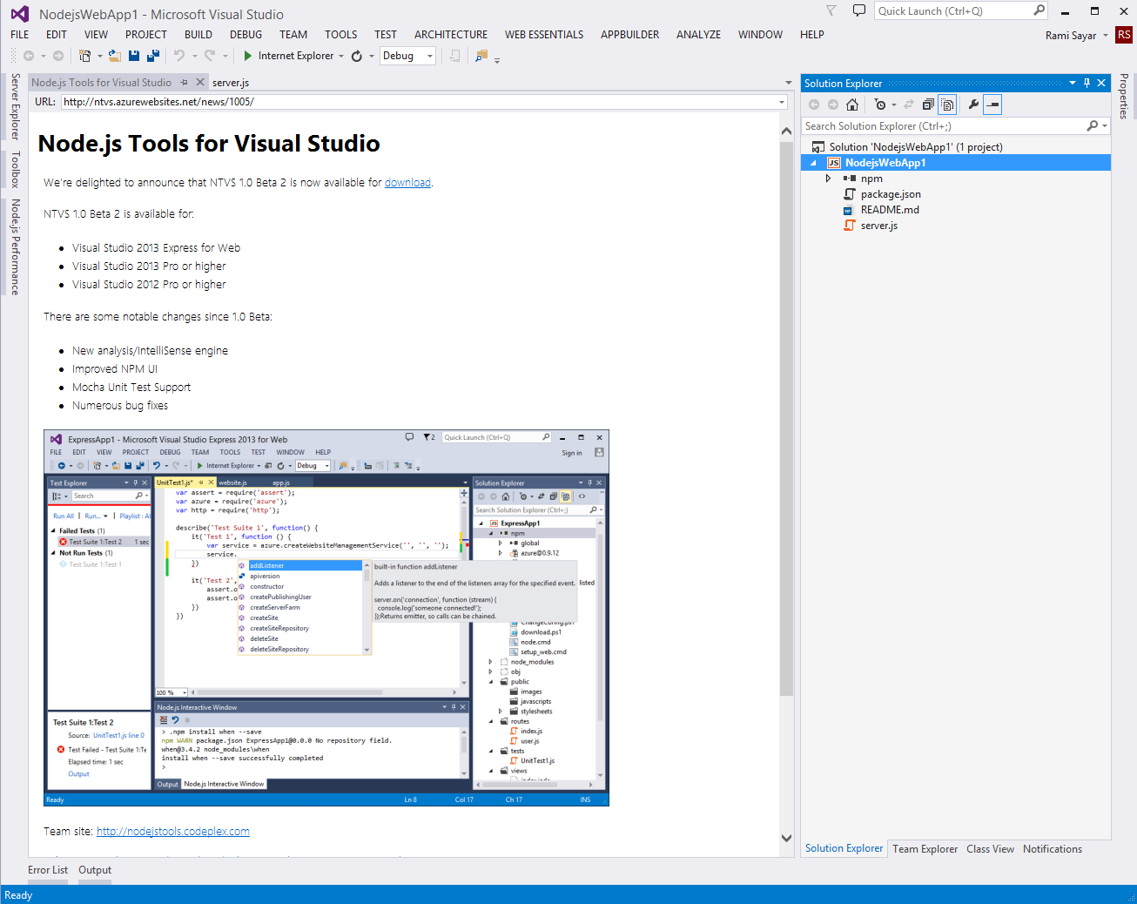
Starting a Node Project in Visual Studio

Slide 25
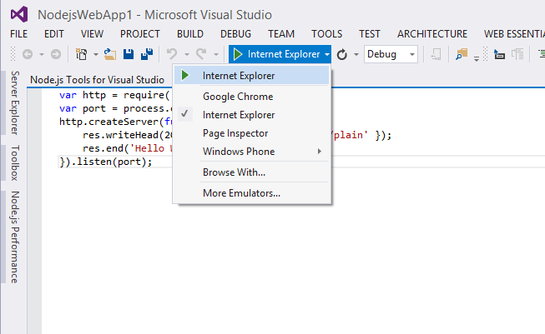
Starting a Node Project in Visual Studio

Slide 26
Basic HTTP Server

Slide 27
Event Driven Programming
“A programming paradigm in which the flow of the program is determined by events such as user actions (mouse clicks, key presses) or messages from other programs.” – Wikipedia

Slide 28
Node Event Loop
Node provides the event loop as part of the language.
With Node, there is no call to start the loop.
The loop starts and doesn’t end until the last callback is complete.
Event loop is run under a single thread therefore sleep() makes everything halt.

Slide 29
Blocking I/O
var fs = require('fs');
var contents = fs.readFileSync('package.json').toString();
console.log(contents);

Slide 30
Non Blocking I/O
var fs = require('fs');
fs.readFile('package.json', function (err, buf) {
console.log(buf.toString());
});

Slide 31
Callback Style Programming
Event loops result in callback-style programming where you break apart a program into its underlying data flow.
In other words, you end up splitting your program into smaller and smaller chunks until each chuck is mapped to operation with data.
Why? So that you don’t freeze the event loop on long-running operations (such as disk or network I/O).

Slide 32
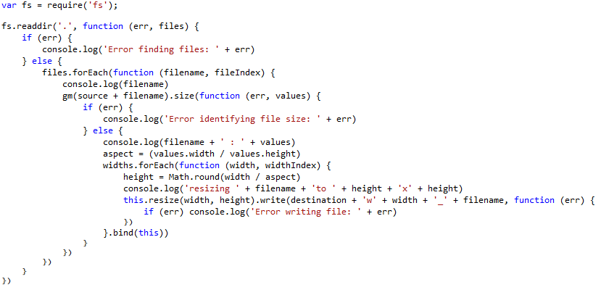
Callback Insanity

Slide 33
Promises
A function will return a promise for an object in the future.
Promises can be chained together.
Simplify programming of async systems.
Read More: http://spin.atomicobject.com/2012/03/14/nodejs-and-asynchronous-programming-with-promises/

Slide 34
Q Library
step1(function (value1) {
step2(value1, function (value2) {
step3(value2, function (value3) {
step4(value3, function (value4) {
// Do something with value4
});
});
});
});
Q.fcall(promisedStep1)
.then(promisedStep2)
.then(promisedStep3)
.then(promisedStep4)
.then(function (value4) {
// Do something with value4
})
.catch(function (error) {
// Handle any error from all above steps
})
.done();

Slide 35
Basic TCP Demo

Slide 36
Event Emitters
Allows you to listen for “events” and assign functions to run when events occur.
Each emitter can emit different types of events.
The “error” event is special.
Read More: http://code.tutsplus.com/tutorials/using-nodes-event-module--net-35941

Slide 37
Streams
Streams represent data streams such as I/O.
Streams can be piped together like in Unix.
var fs = require("fs");
// Read File
fs.createReadStream("package.json")
// Write File
.pipe(fs.createWriteStream("out.json"));

Slide 38
Modules and Exports
Node.js has a simple module and dependencies loading system.
Unix philosophy -> Node philosophy
Write programs that do one thing and do it well -> Write modules that do one thing and do it well.

Slide 39
Require() Module Loading System
Call the function “require” with the path of the file or directory containing the module you would like to load.
Returns a variable containing all the exported functions.
var fs = require("fs");

Slide 40
01 | Node Package Manager (NPM)
Stacey Mulcahy | Technical Evangelist
Rami Sayar | Technical Evangelist

Slide 41
What is NPM?
Official package manager for Node.
Bundled and installed automatically with the environment.
Frequent Usage:
npm install --save package_name
npm update

Slide 42
What is a package.json?
{
"name": "Node101",
"version": "0.1.0",
"description": “MVA Presentation Code",
"main": "1_hello_world.js",
"author": {
"name": "Rami Sayar",
"email": ""
}
}

Slide 43
Popular NPM Modules
Most Depended Upon
7053 underscore
6458 async
5591 request
4931 lodash
3630 commander
3543 express
2708 optimist
2634 coffee-script

Slide 44
How does it work?
Reads package.json
Installs the dependencies in the local node_modules folder
In global mode, it makes a node module accessible to all.
Can install from a folder, tarball, web, etc…
Can specify dev or optional dependencies.

Slide 45
Async Module
Async is a utility module which provides straight-forward, powerful functions for working with asynchronous JavaScript.
async.map(['file1','file2','file3'], fs.stat, function (err, results) {
// results is now an array of stats for each file
});
async.filter(['file1','file2','file3'], fs.exists, function (results) {
// results now equals an array of the existing files
});
async.parallel([
function () { },
function () { }
], callback);
async.series([
function () { },
function () { }
]);

Slide 46
Request Module
Request is designed to be the simplest way possible to make http calls. It supports HTTPS, streaming and follows redirects by default.
var request = require('request'); request('http://www.microsoft.com', function (error, response, body) {
if (!error && response.statusCode == 200) {
console.log(body);
}
});

Slide 47
Using the Q Library

Slide 48
Resources
https://blog.jcoglan.com/2013/03/30/callbacks-are-imperative-promises-are-functional-nodes-biggest-missed-opportunity/
http://code.tutsplus.com/tutorials/using-nodes-event-module--net-35941
http://spin.atomicobject.com/2012/03/14/nodejs-and-asynchronous-programming-with-promises/
Github repo: https://github.com/sayar/NodeMVA

